Slide 1
More algorithms and flowcharts

Slide 2
Exchange value of two variable
Step 1: Start
Step 2: Read the value of Number1,Number2
Step 3: Number1= Number1 + Number2
Step 4: Number2= Number1 - Number2
Step 5: Number1= Number1 - Number2
Step 6: PRINT the value of Number1 and Number2
Step 7: Stop

Slide 3
Exchange value of two variable with using third variable
Step 1: Start
Step 2: Input two numbers say num1, num2
Step 3: Display values of numbers num1, num2 before swapping
Step 4: temp = num1
Step 5: num1 = num2
Step 6: num2 = temp
Step 6: Display values of num1, num2 after swapping
Step 7: Stop

Slide 4
Sum of n natural numbers
Step 1 : Start
Step 2 : Initialize sum=0 and i=0
Step 3 : Read limit of number to be added , n
Step 4 : Repeat steps 5 to 6 until i=n reached
Step 5 : Compute sum=sum+i
Step 6 : Compute i=i+1
Step 7 : Print sum
Step 8 : Stop

Slide 5
Reversing digits of a number
Step 1 : Start
Step 2 : Input num
Step 3 : Initialize rev = 0
Step 4 : Loop while num > 0
(a) Multiply rev by 10 and add remainder of num divide by 10 to rev
rev = rev*10 + num%10;
(b) Divide num by 10
Step 5 : return rev
Step 6 : Stop

Slide 6
Greatest Common divisor (GCD) of two numbers
Step 1 : Start
Step 2 : Read n1 and n2
Step 3 : Initialize gcd=0 and i=0
Step 4 : Repeat until i is less than or equals to n1 and n2
a) if both n1 and n2 are exactly divisible by i, the value of i is assigned to gcd i.e
gcd=i
b) Increment i by 1
Step 5 : Print gcd
Step 6 : Stop

Slide 7
Test whether a number is prime or not
Step 1: Start
Step 2: Take three variables n, i,flag.
Step 3: Initialize variables flag←1 and i←2
Step 4: Read n from user.
Step 5: Repeat the steps until i < (n/2)
5.1 If remainder of n÷i equals 0, set flag←0
Go to step 6
5.2 i←i+1
Step 6: If flag=0,
display n is not prime
else, Display n is prime
Step 7: Stop

Slide 8
Factorial of a number
step 1. Start step 2. Read the number n step 3. Initialize i=1, fact=1 step 4. Repeat step 4 through 6 until i=n step 5. fact=fact*i step 6. Increment i by 1 step 7. Print fact step 8. Stop

Slide 9
Fibonacci series
STEP 1. START.
STEP 2. Initialize A = 0 , B = 1 , COUNTER = 0 .
STEP 3. INPUT N, to print N terms of Fibonacci series
STEP 4. Display values of A and B
STEP 5. REPEAT STEP 6 TO 10 until COUNTER < N -2
[ N - 2 IS WRITTEN BECAUSE FIRST TWO TERMS ARE ALREADY DISPLAYED]
STEP 6. SUM : = A + B
STEP 7. PRINT SUM
STEP 8. SET A : = B
STEP 9. SET B : = SUM
STEP 10. INCREMENT THE VALUE OF COUNTER BY 1
COUNTER : = COUNTER + 1
STEP 11. STOP

Slide 10
Flowcharts

Slide 11
Exchange value of two variable
START
Input X,Y
X=X+Y
Y=X-Y
X=X-Y
Print X,Y
STOP

Slide 12
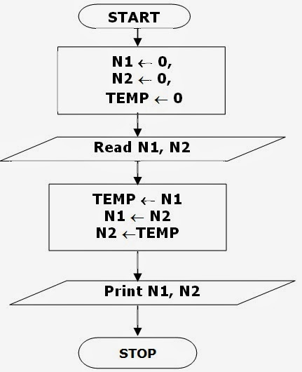
Exchange values of two variable with using third variable

Slide 13
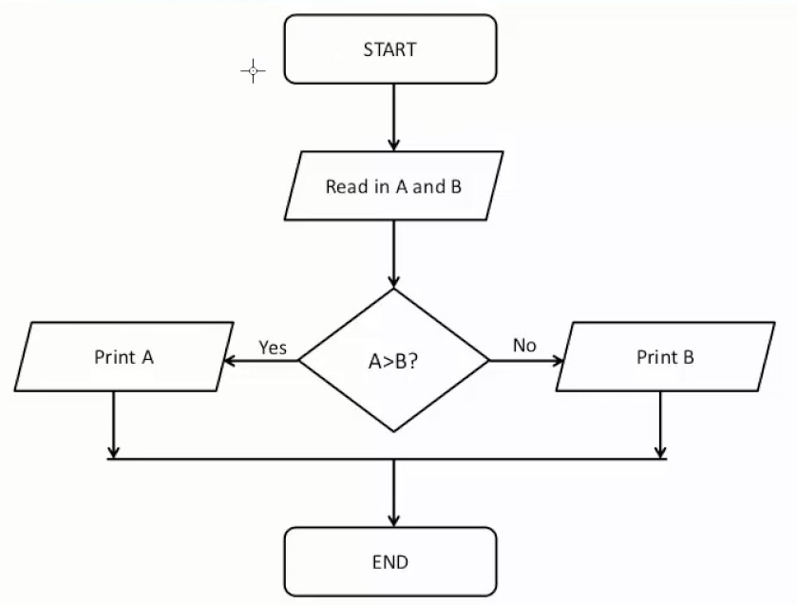
Find largest number from given two numbers

Slide 14
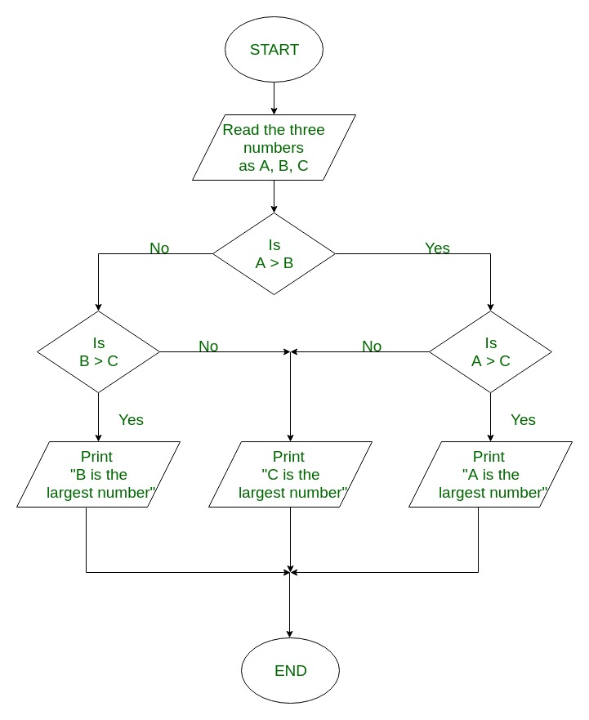
Find largest number from given three numbers

Slide 15
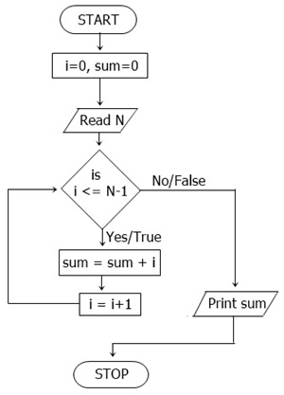
Sum of first n numbers

Slide 16
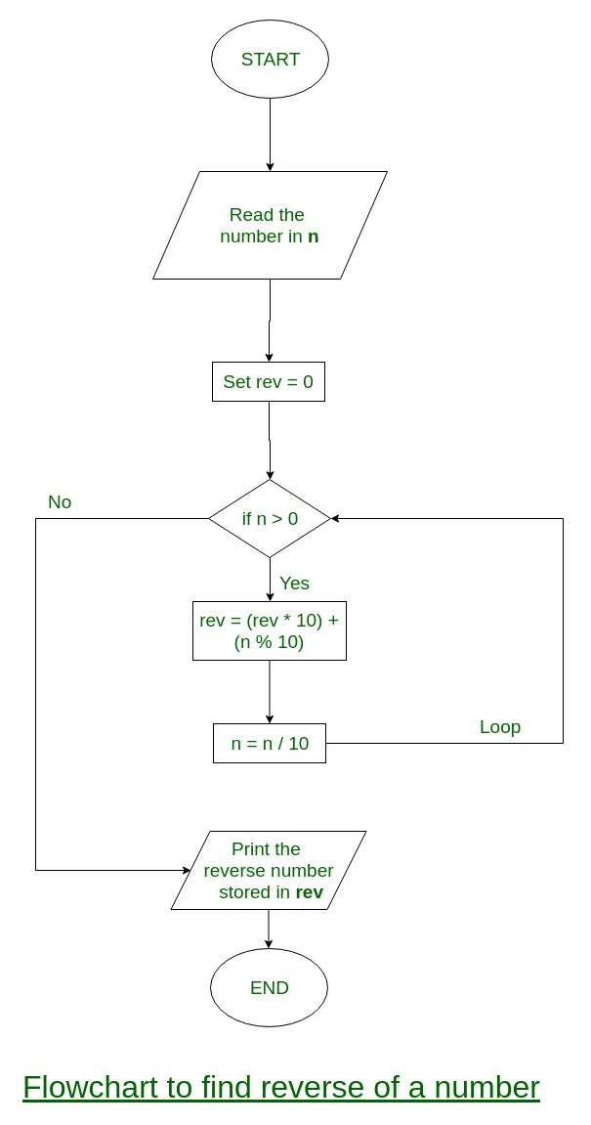
Find reverse of a number

